Slide 1
Impossibility of Distributed Consensus with One Faulty Process
Xander Fang

Slide 2
Content
Summary
Model / Definitions
Lemmas / Proof

Slide 3
Summary

Slide 4
Summary / Background
No total correct asynchronous consensus protocol can tolerate even one faulty process
Consensus
Synchronous
Asynchronous

Slide 5
Summary / Background
No total correct asynchronous consensus protocol can tolerate even one faulty process
Consensus
All the computers must collectively agree on the output of this value
Synchronous
Asynchronous

Slide 6
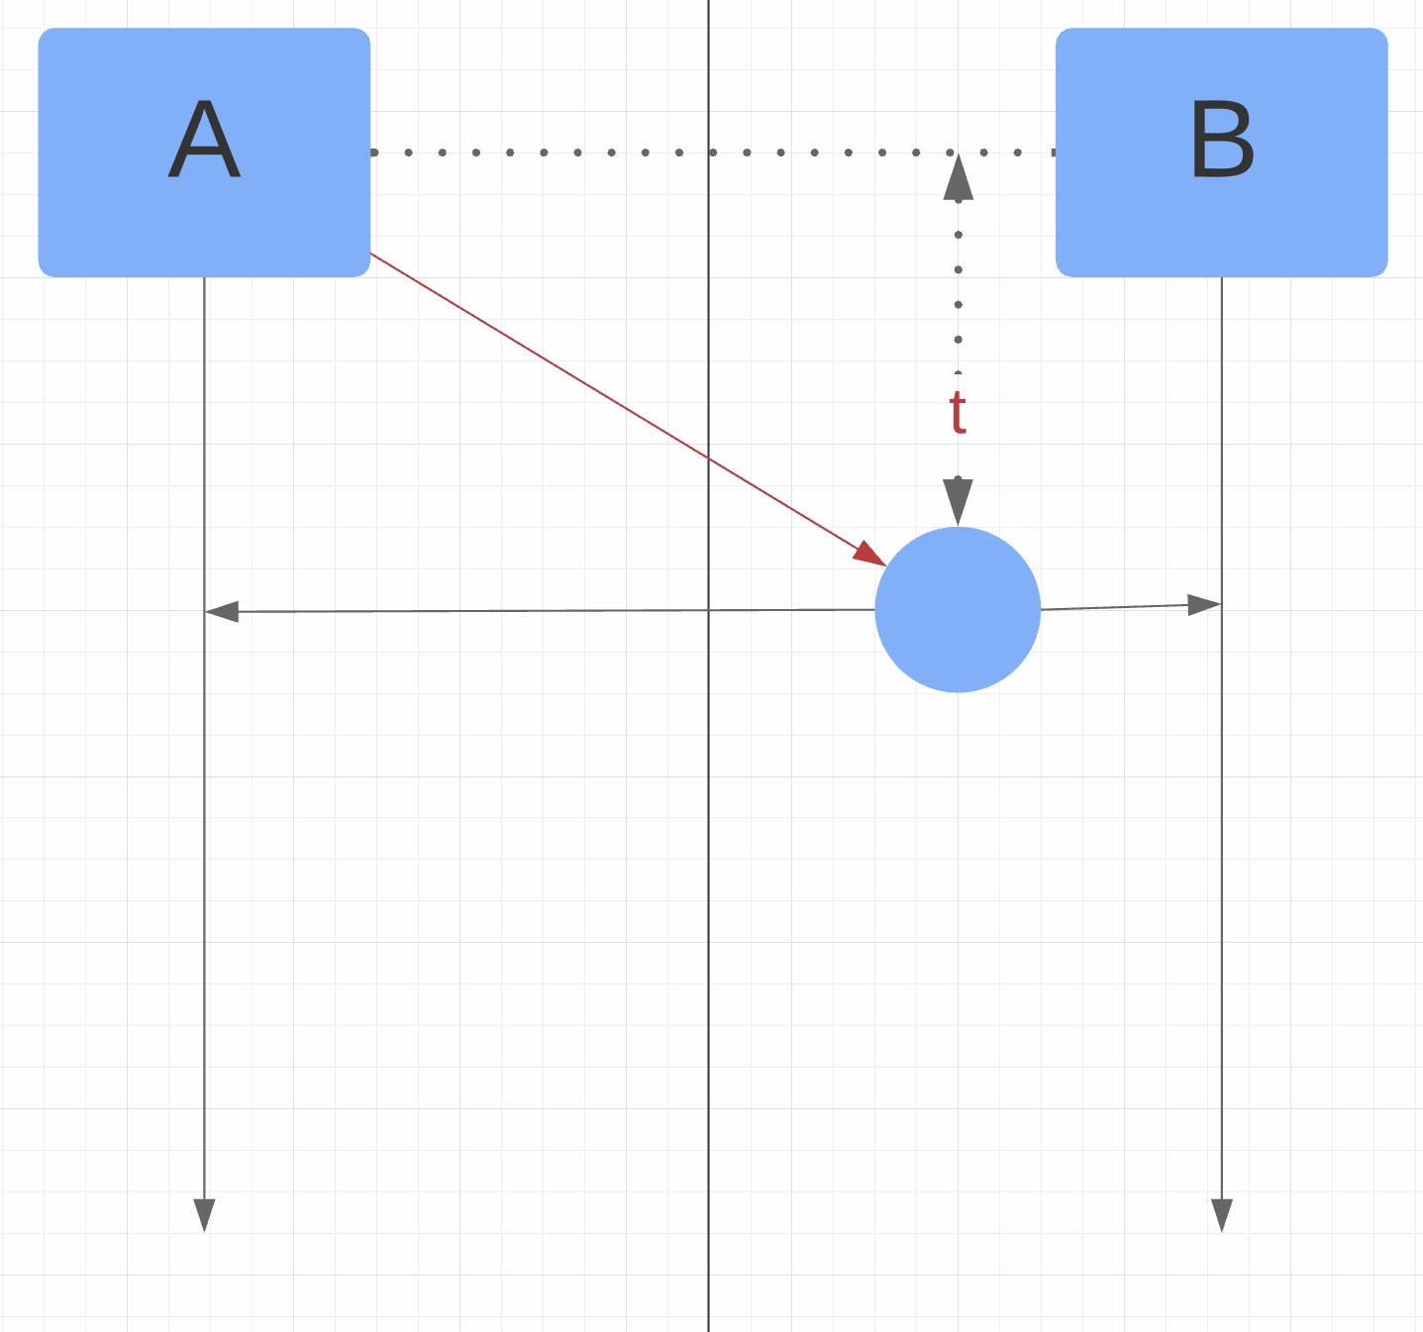
Summary / Background
No total correct asynchronous consensus protocol can tolerate even one faulty process
Consensus
Synchronous
Upper bound time
Asynchronous
No Upper bound time

Slide 7
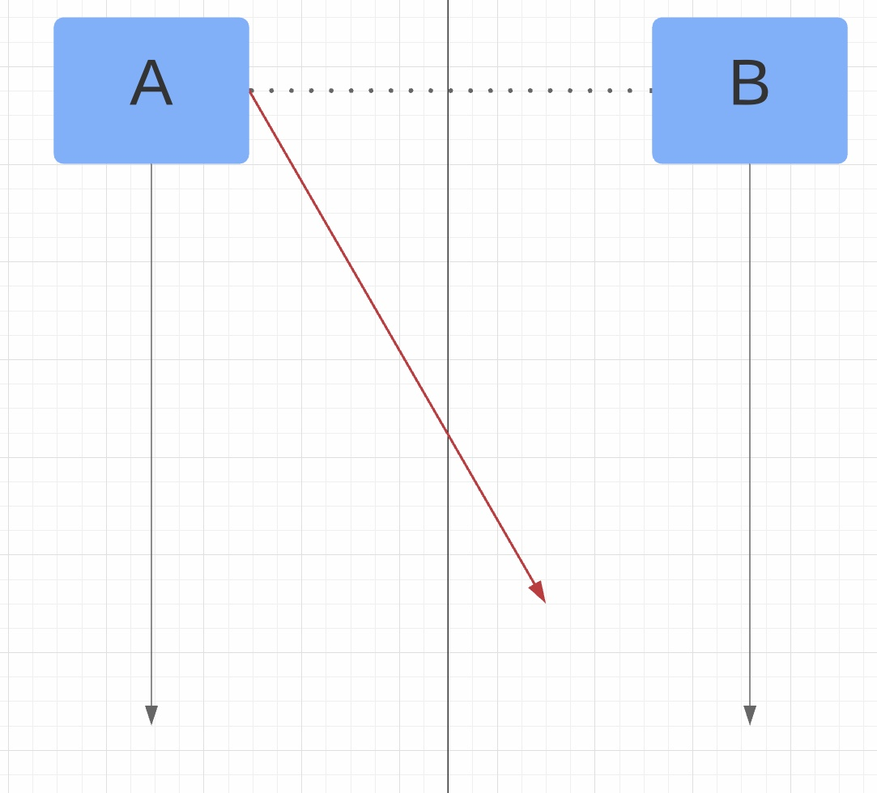
Summary / Background
No total correct asynchronous consensus protocol can tolerate even one faulty process
Consensus
Synchronous
Upper bound time
Asynchronous
No Upper bound time

Slide 8
Model / Definitions

Slide 9
Model / Definitions
Process
Input Register
Value: {0, 1}
Output register
Value: {0,,1, null}
Internal storage
Unbounded

Slide 10
Model / Definitions
Internal state
Value of Input Register
Value of Output register
Internal storage
Program counter
Decision State
Value of Output register is 0 or 1

Slide 11
Model / Definitions
Transition Function
Input register value -> Output register value

Slide 12
Model / Definitions
Features of Process
Deterministic
Input Register + Transition Function
Output register: “Write-Once”
When process reaches a decision state
Transition function cannot change value anymore

Slide 13
Model / Definitions
Process Communication
Message
Pair(p,m)
Store in Message Buffer
Message Buffer
Abstract data structure
Multiset
Nondeterministic

Slide 14
Model / Definitions
Two Operations of Process Communication
Send(p,m)
Receive(p)

Slide 15
Model / Definitions
Two Operations of Process Communication
Send(p,m)
Receive(p)
Return Message Buffer Randomly or Null

Slide 16
Model / Definitions
Two Operations of Process Communication
Send(p,m)
Receive(p)
Return Message Buffer Randomly or Null
Perform infinitely times

Slide 17
Model / Definitions
Configuration
All internal States in one process
Content of message buffer

Slide 18
Model / Definitions
Step
One configuration to another
Determined by the event
Event
A pair e=(p,m)

Slide 19
Model / Definitions
Schedule
Sequence of events
Run
Sequence of steps associated

Slide 20
Model / Definitions
Reachable Configuration
The number of events from C is finite -> Reachable from C
Accessible Configuration
Reachable from the initial configuration

Slide 21
Model / Definitions
Nonfaulty Process
A process p in a run takes infinite steps.
Faulty Process
A process p in a run takes finite steps.

Slide 22
Model / Definitions
Admissible Run
At most one process is faulty
All messages sent to nonfaulty processes are eventually received
Deciding Run
Process reaches a decision state in that run

Slide 23
Model / Definitions
Bivalent configuration / Univalent configuration
C is a configuration
V is the set of decision value of configurations reachable from C

Slide 24
Model / Definitions
Bivalent configuration
The number of V is 2
Univalent configuration
The number of V is 1
0-valent or 1-valent

Slide 25
Model / Definitions
Totally Correct Protocol
Every admissible run is a deciding run

Slide 26
Lemmas / Proof

Slide 27
Lemma -> Conclusion
Goal: Find some circumstances make all the protocols remain indecisive forever
Show there is some admissible run ->
This run is not deciding run ->
There is one initial configuration will not work because starting in that configuration can never be ruled out, which runs forever ->
Every stage in the construction of the infinite schedule succeeds ->
P is not totally correct.

Slide 28
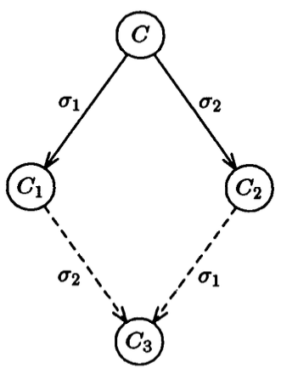
Lemma 1
Configuration C, the schedules 𝝈₁,𝝈₂ (lead to configurations C1, C2, respectively). If the sets of processes taking steps in C₁ and C₂ are disjoint.
Then 𝝈₂ can be applied to C₁ and 𝝈₁ can be applied to C₂,and both lead to the same configuration C₃.
“Commutative Property”
“XY = YX”
“Vector Addition”

Slide 29


Lemma 2
P has a bivalent initial configuration
Assume not. Protocol P must have both 0-valent and 1-valent initial configurations.

Slide 30
Lemma 2
P has a bivalent initial configuration
Assume not. Protocol P must have both 0-valent and 1-valent initial configurations.
Put initial configurations into a chain.

Slide 31
Lemma 2
P has a bivalent initial configuration
0-valent initial configuration C₀ adjacent to a 1-valent initial configuration C₁.
Process p represents where difference happens

Slide 32
Lemma 2
P has a bivalent initial configuration
Admissible deciding runs from C₀ and C₁
Process p takes no steps
The two runs eventually reach the same decision value.
If the value is 1, then C₀ is bivalent.
If the value is 0, then C₁ is bivalent.
𝝈
𝝈

Slide 33
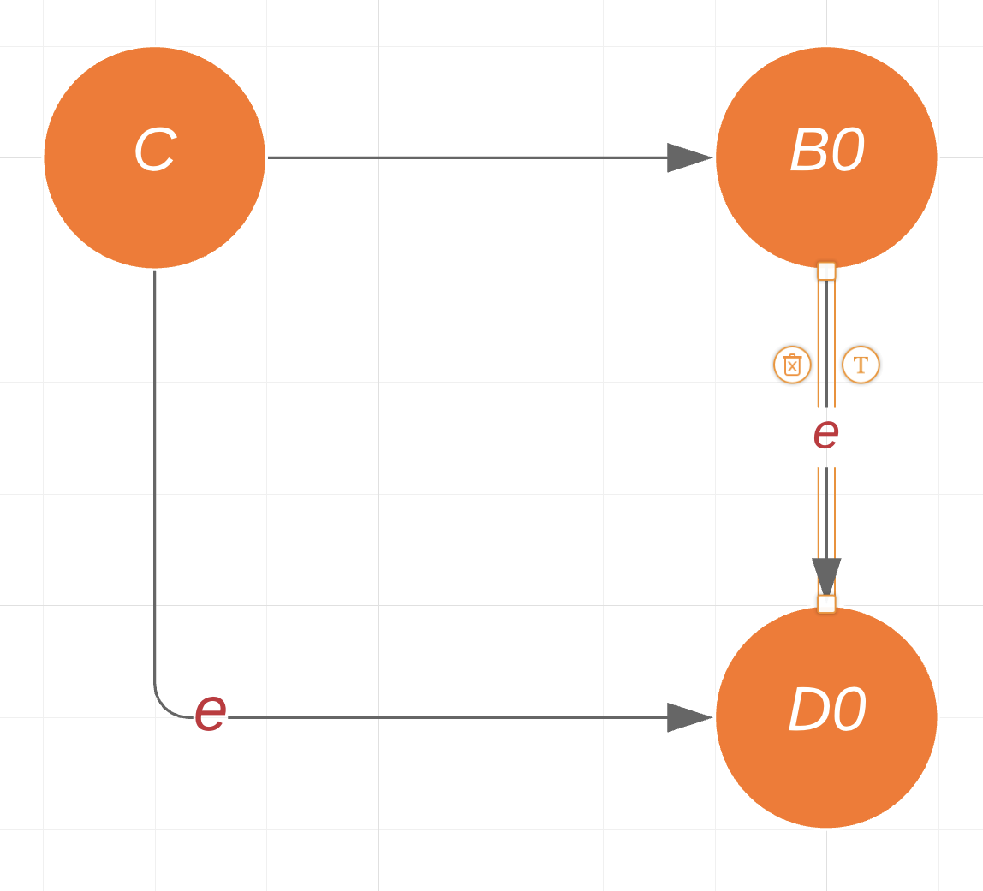
Lemma 3
Let C be a bivalent configuration of P, and let e = (p, m) be an event that is applicable to C.
Let B be the set of configurations which is reachable from C without applying e. And let D = e(B) = {e(E_{i}) | E_{i} from B and e is applicable to E_{i}}.
Then, D contains a bivalent configuration.

Slide 34
Lemma 3
Prove:
Assume D contains no bivalent configurations.
E_{i} belongs to B, F_{i} belongs to D.
F_{i} = e(E_{i}).
C₁ is the neighbor of C₀.
C₀ belongs to B.
C₁ = e’(C₀), where e’ = (p’, m’)

Slide 35
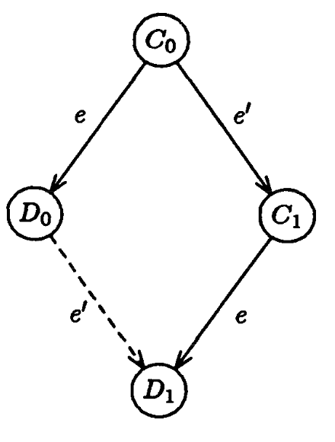
Lemma 3
Case 1: Process p != p’
D₁ = e’(D₀)
Bivalent Configuration

Slide 36
Lemma 3
Case 2: Process p == p’
𝝈 is the corresponding schedule
A = 𝝈(C₀)
E_{i} = 𝝈(D_{i}),

Slide 37
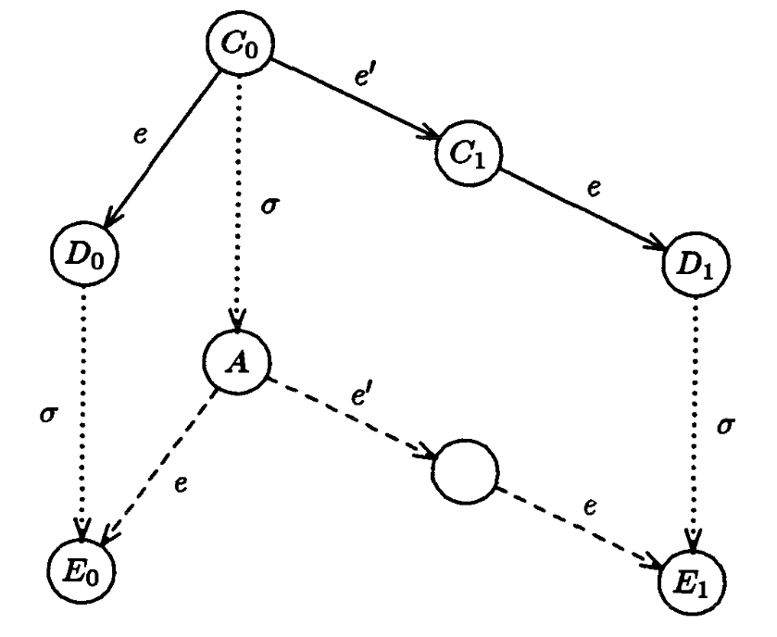
Lemma 3
Case 2: Process p == p’
e(A) = E₀ && e(e’(A)) = E₁
A is bivalent configuration

Slide 38
Lemma -> Conclusion
Goal: Find some circumstances make all the protocols remain indecisive forever
Show there is some admissible run ->
This run is not deciding run ->
There is one initial configuration will not work because starting in that configuration can never be ruled out, which runs forever ->
Every stage in the construction of the infinite schedule succeeds ->
P is not totally correct.

Slide 39
Proof
Make the run admissible
Put the processors into a queue
Receive messages in queue order
Place at the back of the queue when finish

Slide 40
Proof
Run forever / No decision
e=(p, m) be the earliest message to the first processor in the queue
According to Lemma 3
C₀ -> C₁ (bivalent configuration)
C₁ -> C₂ (bivalent configuration)
…….

Slide 41
Thanks

